Slide 1
Endpoints Operations
Monthly Operations Summary
JL IT
September 2022

Slide 2
Executive Summary
Incident Management saw incident volume remain steady in September (3,325). The first call resolution, or FCR, was 85.4%. The overall SLA goal across all teams was met at 90.7%.
Service Desk call volume remained largely the same at 2,800 in September. Calls answered within 30-, 60-, and 90- seconds goals were surpassed. Average speed to answer was 33 seconds. The abandonment rate goal for the month was also surpassed at 4.8%. SLA goals were met by the Service Desk with an overall SLA score of 97.5%.
Technology Operations assignment groups opened or received 437 incidents across the month. Critical alerts dropped for a third consecutive month and were 23% less month over month.
Endpoint Engineering Auto Pilot configuration and testing continues. We are currently evaluating packet captures as we try to determine why we have location inconsistencies. Window’s 11 testing also continues. We have it installed on approximately 20 systems in IT with no issues to date. We are building an application/web site test plan for both Windows 11 and the removal of IE.
Endpoint Projects NextGen started again the second week of August. We completed 6 locations (Cincinnati, Dayton, Norfolk, Philadelphia, White Plains, and Tampa). Self Service Password Reset has been deployed to the Pilot offices and we have had 121 enrollments or approximately 60%. We are currently waiting on a patch that will fix some vulnerabilities before deploying nationwide. Final amenities form for the Conference Room project has been configured in our test environment. We will be demonstrating it for the OA’s in September.

Slide 3
Incident Management Summary
Service Desk Summary
Technology Operations Summary
Endpoint Engineering Summary

Slide 4
Incident Management

Slide 5
Incident Statistics
3,325 incidents were opened during the month, across all groups within SNOW. 23.7% of incident volume were emails.
Phone: 2477
Email: 787
Self-Service: 40
Walk-in: 20
First contact resolution lowered slightly in September to 85.4% (as opposed to 86.6% in August).

Slide 6
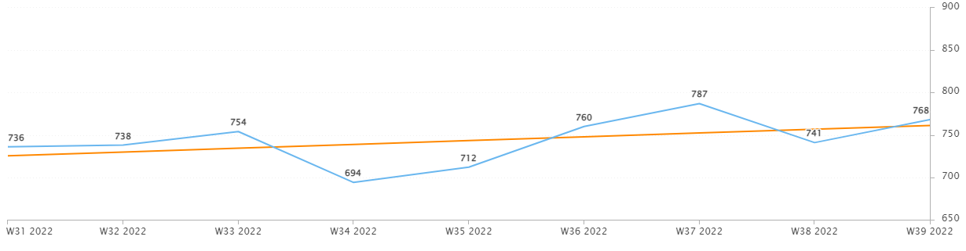
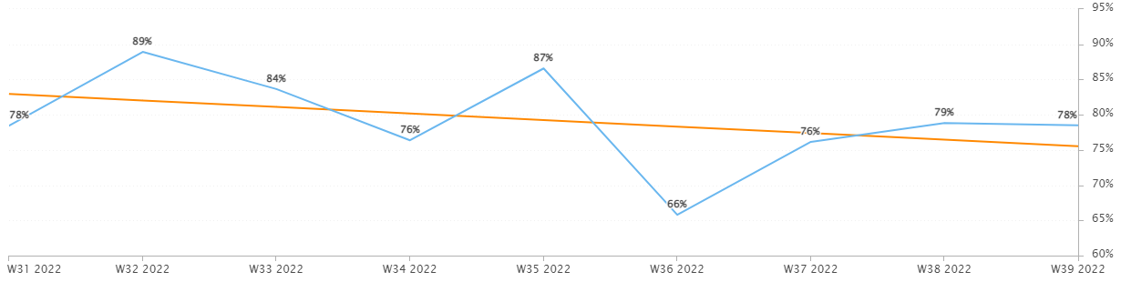
Incident Statistics
Incidents Opened by Week
Incidents opened by week continued to trend upward.
The percentage of incidents resolved the same day that they were opened trended downward in September.
Percentage of incidents resolved; same day opened.

Slide 7
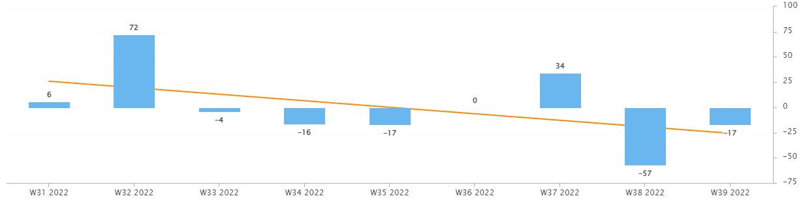
Incident Statistics
Open Incident Backlog Growth
In September, backlog growth continued to trend downward. Reminders sent regarding oldest incidents helped push teams to close their older incidents.
Notes:
Backlog growth is a way of answering, “did we end the week with more or less incidents?”.

Slide 8
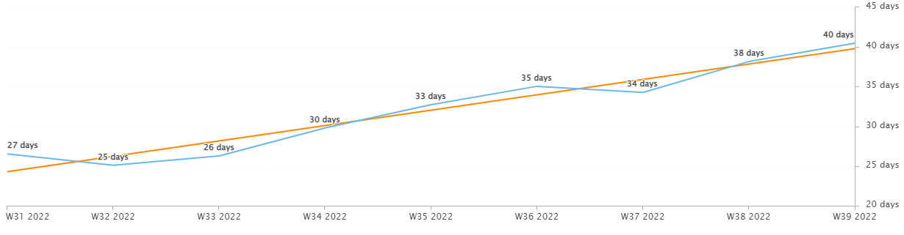
Incident Statistics
Average Age of Open Incidents
In September, the average age of open incidents trended upward. Nearing the end of the month, reminders were given during service stand-ups. Please work with your teams to work first in, first out and close their aging incidents.
Notes:
Please remind your teams to continue to work on their open incidents- this affects many of the previous slides as well as this one.

Slide 9
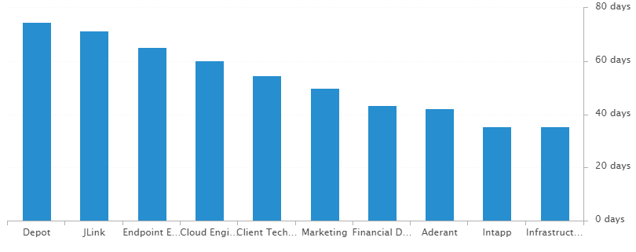
Incident Statistics
Average Age of Open Incidents by Assignment Group - as of the last day of the month

Slide 10
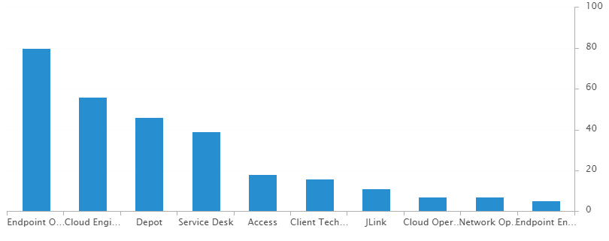
Incident Statistics
Open Incidents by Assignment Group - as of the last day of the month

Slide 11
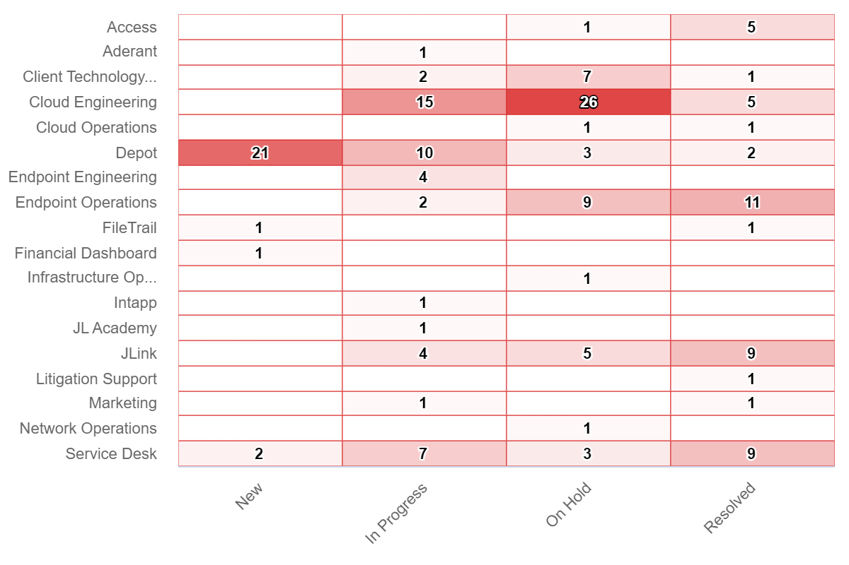
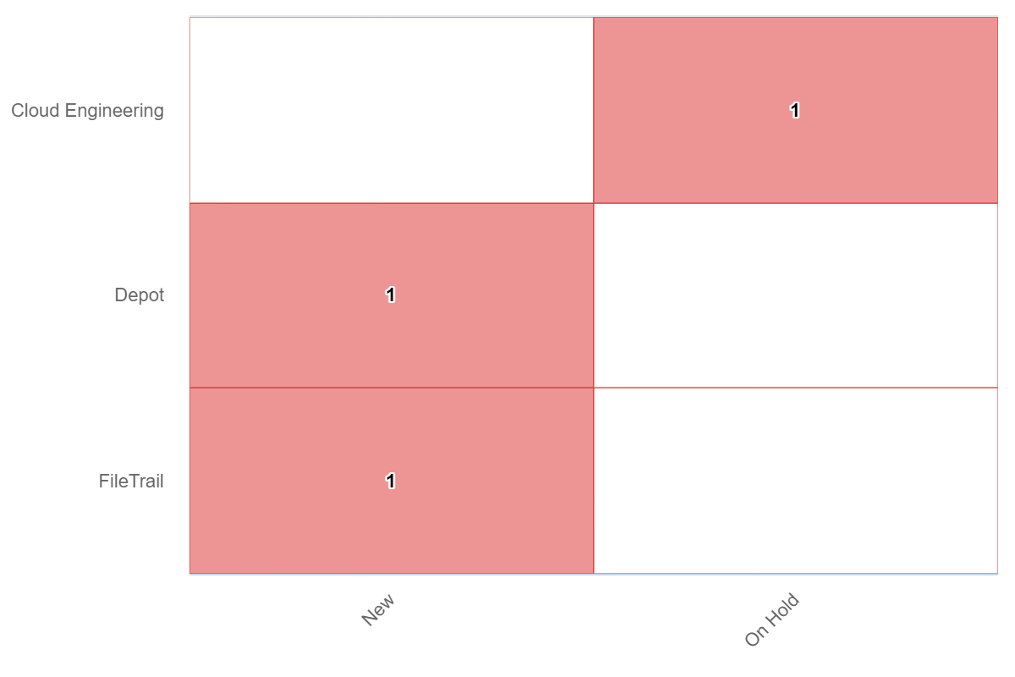
Incident Statistics
Open Incidents Older than 30 Days
Open Incidents not updated in last 30 days

Slide 12
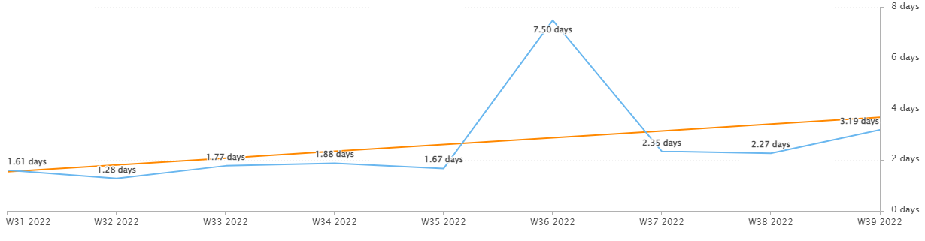
Incident Statistics
Average Resolution Time of All Resolved Incidents
The average resolution time trended upward across the month.

Slide 13
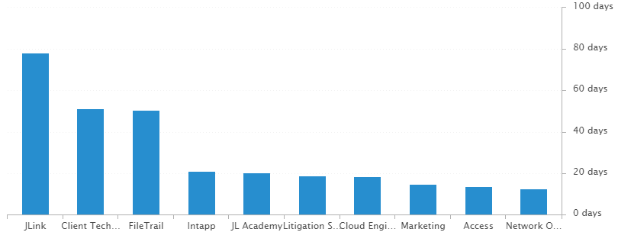
Incident Statistics
Average Resolution Time of Resolved Incidents, by Assignment Group

Slide 14
2022 SLA Goals & Actuals
Month | January | February | March | April | May | June | July | Aug | Sept | Oct | Nov | Dec
Goal | 90% | 90% | 90% | 90% | 90% | 90% | 90% | 90% | 90% | 90% | 90% | 90%
Actual | 88.8% | 88.1% | 92.7% | 92% | 90.6% | 93.9% | 91.6% | 91.2% | 90.73%
The Incident SLA goal in September was met across all teams.

Slide 15
Problem Statistics
Open Problems
Problem | Date of most recent update | Assignment Group
PRB0010189 | 2022-09-20 | Cloud Engineering
PRB0010474 | 2022-09-20 | Network Operations
PRB0010541 | 2022-07-20 | Security
PRB0010542 | 2022-07-27 | Intapp
PRB0010543 | 2022-10-04 | Cloud Engineering
PRB0010587 | 2022-09-20 | Cloud Engineering
PRB0010595 | 2022-08-31 | Telco Operations
PRB0010598 | 2022-09-20 | Cloud Engineering
PRB0010606 | 2022-10-03 | Endpoint Operations
PRB0010617 | 2022-09-22 | Endpoint Operations

Slide 16
Service Desk

Slide 17
Year over Year Quarterly Results
Total incident and call volume reduced in Q3 2022 over 2020 & 2021.

Slide 18
Key Call Statistics
Call volume remained steady in September with 2,800 calls.
The goal was met, ending the month with 4.82%.
The abandonment rate monthly goal is 9%.
Notes:
~
There are several stats tracked for individual analysts as well as for the team and the org. Across the next few slides I’ll highlight some key statistics for the Service Desk team.

Slide 19
Key Call Statistics
The Service Desk met all 3 goals for each range. This correlates with the call volume and abandonment rates.
The goals for each time period:
70% of calls handled within 30 seconds.
75% of calls handled within 60 seconds.
80% of calls handled within 90 seconds.
Notes:
Over 75% of calls were handled within 30 seconds.
Over 80% were handled within 60 seconds.
Over 83% were handled within 90 seconds.
~
We track multiple metrics for calls handled- or how quickly a call is answered- within specific time periods. I’ve highlighted three here, calls handled within 30, 60, and 90 seconds.
The takeaway from these numbers should be that we are answering calls quickly which prevents calls from abandoning. Typically, we see the abandoned calls rise when these goals are not met- specifically the 60 seconds metric.

Slide 20
Key Call Statistics
The average speed to answer was 33 seconds which correlates with the trend of call volume & abandoned calls alongside the higher percentages for the calls handled within 30, 60, and 90 seconds.
Notes:
~
Average speed to answer is the average of how quickly all calls were answered by the Service Desk for the month.

Slide 21
Incident Statistics
Closed Monthly Data:
Incidents closed by SD: 2,696
Total Closed Incidents: 3,267
Closed by SD Percentage: 82.52%
Incidents closed by Service Desk, by Source:
Phone: 2,395
Email: 803
Self-Service: 43
Walk-in: 26
Notes:
~
The typical methods for contacting the Service Desk are phone and email, which explains the results in the incident source chart.
Self-Service we hope to expand over the next year and drive users towards generating their own incidents and using the JL Service Center more actively.
Walk-ins are low month-to-month with the split schedule for Return to Better. But from analyst feedback incidents for walk-ins are not being opened consistently. I aim to correct this over the rest of this year. I’ve also added it as a 2022 goal for each analyst within their reviews.

Slide 22
Incident Statistics
Top 5 Subcategories:
Microsoft Office (600)
NetDocuments (416)
Active Directory (243)
Power PDF (156)
Printer (123)
Top 5 Customers:
Greisy Ledo (22)
Penny Ann Leiberman (18)
Beth Davis (17)
Joseph Galagaza (17)
Susan Vanderburgh (17)
Average Incident/employee/month: 1.80
Average Incident/new hire/month: 2.89
Notes:
Across the month _had the highest number of related incidents.
Top 5 customers in the month are listed here.
Looking at the chart, we’re tracking incident volume per new-hire per month and comparing this to last year.

Slide 23
2021 Service Desk SLA Statistics
Survey Response Comment Highlights:
Sandy – “Super nice to work with”
Dan – “IT was helpful and responded quickly and efficiently to the issue.”
Marcus – “Helpful as always! Love my IT team.”
“Stéphane did a great job allowing me to express the problem without using proper terms and was able to diagnose my issue with no trouble.”
“Ultimately, 4 people were involved in helping me with this problem - Blaise, Stephane, Keith, and Leighton. My computer had to be reimaged. All four people were extremely helpful and made the whole experience as seamless as possible. Huge shout out to IT.”
September | Breached | Has not Breached | SLA %
Response | 71 | 2626 | 97.3%
Resolution | 57 | 2640 | 97.84%
Overall | 128 | 5266 | 97.57%
Response & Resolution SLA timers are determined by the Priority of the Incident.
Both Response and Resolution SLA reviewed on this slide are across all Priorities.
Notes:
Service level agreements/SLA
Response & Resolution SLA timers are determined by the Priority of the Incident.
Both Response and Resolution SLA reviewed on this slide are across all Priorities.
~ The Service Desk team is uniquely prepared to meet SLA goals. We generate incidents during calls, while emails generate their own incidents.

Slide 24
Knowledge Statistics
Top viewed articles, Self Service:
How do I contact the Service Desk?
How to configure JL email on your iOS device
How to install a network printer
How to clear your browser cache
Top viewed articles, IT:
Escalation paths and category guide
JL Storage & Network Drives
TeamViewer: Remote Control
Litera FAQs
Average Article rating: 4.65/5 Did you know?
1,304 searches were made from within the JL Service Center by 163 unique users.
These searches were across both Knowledge & Service Center.
Notes:
Knowledge within Service Now, is maintained by a few of us in the Service Desk team.
We evaluate resolved Incidents that have been flagged for knowledge.
On most of these flagged Incidents the fix or solution are not detailed by the escalated teams.
Knowledge is split into 2 sections. IT visible and Self-Service.
Please push your teams to write out the steps taken to resolve an issue, whenever possible.
This helps with knowledge but also helps when a user has a repeat issue, or the issue occurs for another user.
Reminder: your teams can generate their own knowledge articles. These will be used to increase our first call resolution and avoid escalating incidents.

Slide 25
Update & Reminder Highlights
OneDrive Account access: When a user is separated, via the form in Service Now, the manager may select who will receive access to the separated user’s OneDrive Account.
The user who receives access will receive a link via the task/email.
This is the only reason OneDrive account access is typically given.
A Knowledge Article has been added to more clearly describe this.
New Team Member: Jammie Lipsey joins the Service Desk next Monday in the LA office. Jammie has been added to the Endpoints Teams chat. Please join me in Welcoming them!
International Travel Access request: Please ask users to fill out this form ahead of travel to another country.
This form is under the access category in the Service Catalog.
The task is then assigned to Security to review the request and provide the needed access.
no approvals are required on these, so they go straight to Security without a delay.
Departure: Please join me in wishing Nate all the best in his next role! His last day with JL will be today, September 16th. Good Luck, Nate!
Subcategories: PAAC and Foundation have been added to the Web Based category.
Open Role: The help desk analyst position in LA has been posted in Workday and our recruiting sites and we’re beginning to source candidates. One last reminder to contact me if you have anyone you would like to refer as a part of our referral program.
Annual Evaluations: Beginning next week you’ll be able to complete a self-evaluation within Workday.
These are not mandatory, but I recommend going through the exercise of completing a self-evaluation.
Notes:
Some highlights from the month’s U&R emails are listed here.
One to two emails are sent a week to the Service Desk reminding them, or updating them on, changes to existing workflows or policies. Quick notes sent via Teams are also rolled up into these emails to be sure that these points are not missed. All U&R emails are listed in Confluence for reference by other teams.

Slide 26
Technology Operations

Slide 27
Escalation Status

Slide 28
Escalation Baselines

Slide 29
Logic Monitor Alerts
Uptime (484 alerts) – Reboots on servers not placed in SDT
CPU (895 alerts) – CPU passing thresholds set in place – Must further fine tune top 5 VM’s
AlertComplex (577 alerts) – Related to Silver Peak and Citrix VDS where Logic Monitor can’t poll data.
Idle Interval (309 alerts) – Mostly Critical alerts on Silver Peak devices that LM can’t poll data for short period.

Slide 30
Resource Uptime
Resource | July | August | September
Aderant | 99.773% | 100% | 99.936%
Intapp Walls | 99.996% | 100% | 100%
JL - Home | 99.935% | 99.503% | 44.393%
JLink | 100 | 99.996% | 99.922%
NBI | 99.993% | 99.525% | 44.427%
Payments Credit Card | 99.764% | 99.957% | 100%
Dashboard | 100% | 100% | 100%
Biscom | 99.967% | 99.997% | 100%
Citrix | 100% | 100% | 99.928%
VPN East | 99.979% | 99.997% | 100%
VPN West | 100 | 99.73% | 99.973%
Logic Monitor Collector Polling
JL – Home and NBI were set with a service account with an expired password. This was resolved. The health status showed the site was up (no critical alert) but unable to get a healthy status code to log in.

Slide 31
Endpoint Engineering

Slide 32
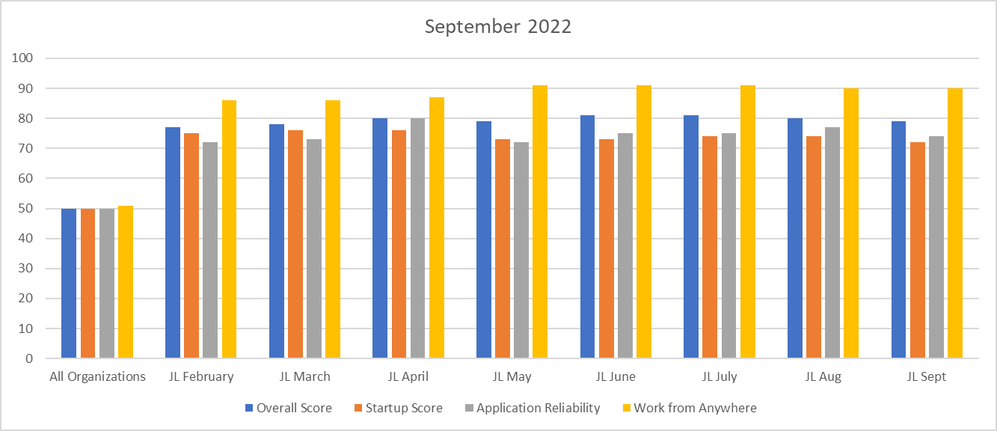
Endpoint Analytics
Overall score fell one point to 79 from August primarily due to 21H2s Feature Update deployed into production.
Startup and App Reliability fell some to 71 and 73 primarily due to 21H2s Feature Update making it out to production.
Also, introducing new apps to assist our MS Office suite are affecting this category slightly.
Work from Anywhere holding at 80. Soon when we restore our CMG, we will regain up to 6 points for this category.

Slide 33
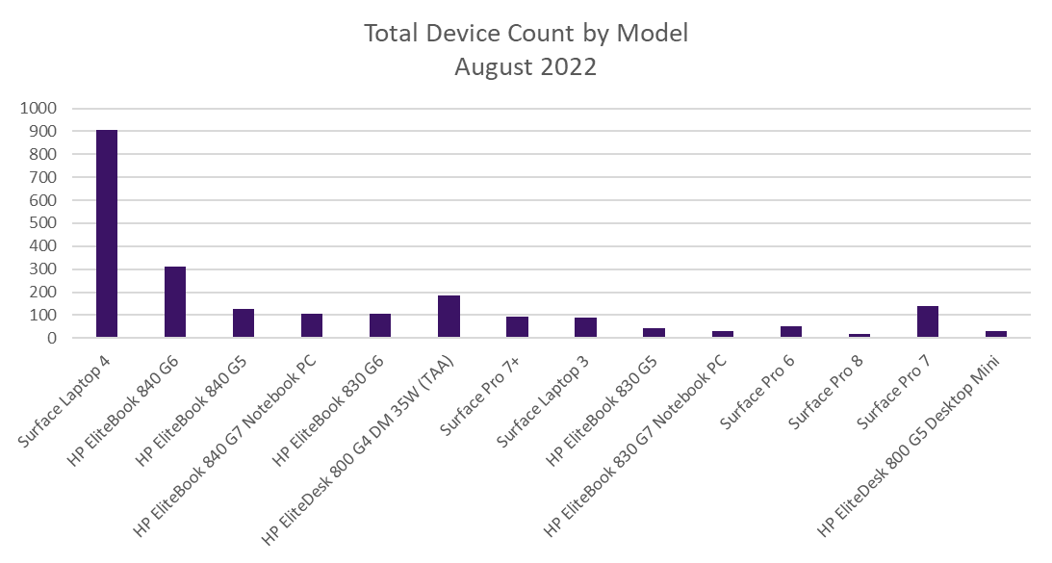
Endpoint Model Inventory
Continuing the trend of replacing our hardware with Microsoft products, giving us increased performance and reliability.
954 total Surface Laptop 4s – Best overall performer
14 Remaining Surface Pro 5s - Worst oveall performer

Slide 34
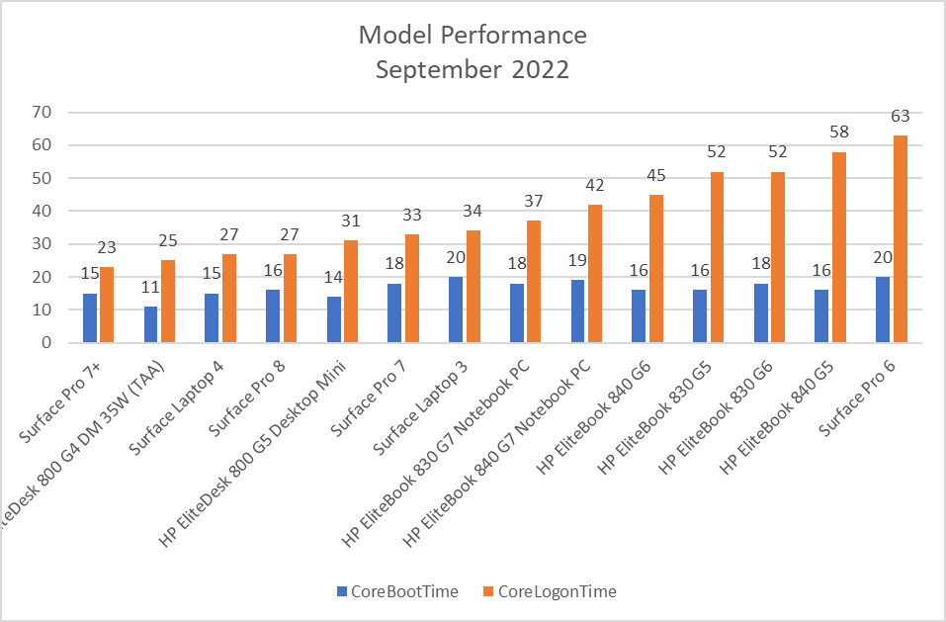
Endpoint Model Performance
With only 14 Surface Pro 6s remaining, this worst performer will be replaced from our environment by our current best performing model, Surface Pro 7+.
NextGen resuming this month will continue to improve our scores as well as save time overall. 945 total HP models(Laptop's and Desktop Mini's) still used. NextGen looks to replace the majority of these over the next few months.

Slide 35
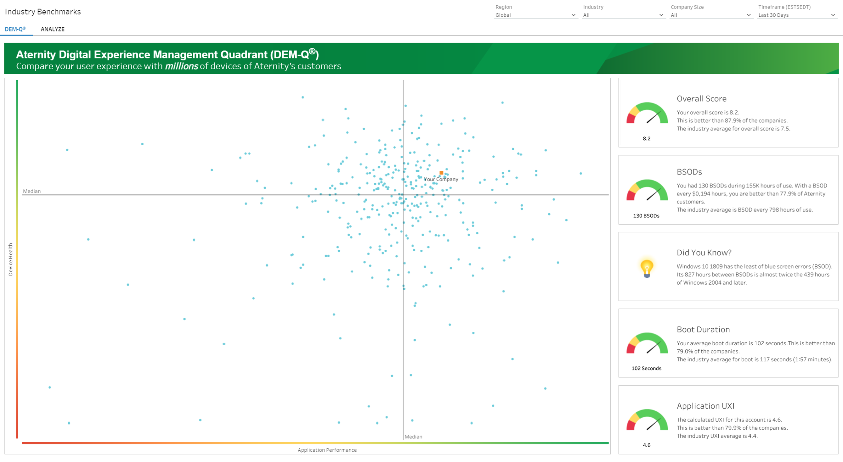
Aternity DEM-Q Performance
DEM-Q fell to 8.2, down 0.1 from August. 21H2s production deployment(now on 1871 PCs) hindered this number slightly.
Boot duration rose by 2 to 102secs as the push of 21H2 finally hit all production PCs over the majority of September.
App UXI is still holding at 4.6, now better only than 79.9% of companies.

